Slide 1


KNIME Presentation Clustering
Aashish Kumar

Slide 2
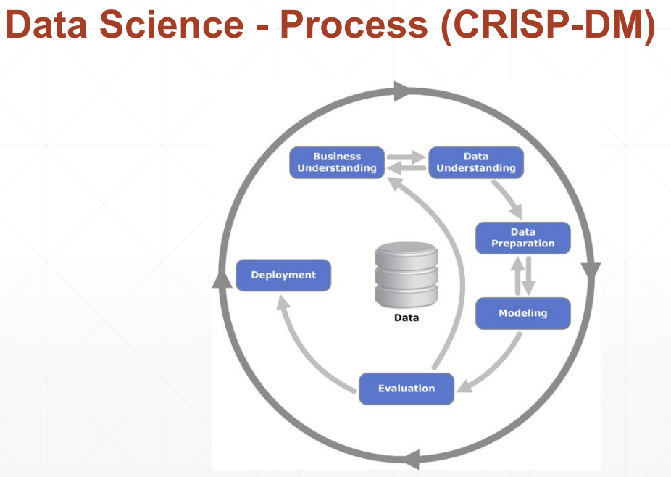
Following the CRISP-DM Model
Goal is to perform clustering using K-Means using your ERP ID as a seed value. Identify the optimal number of clusters using the Elbow curve technique taught in the class)
We will follow the CRISP-DM model to make workflows on KNIME and arrive on the optimum result.
We will evaluate and interpret clusters.

Slide 3

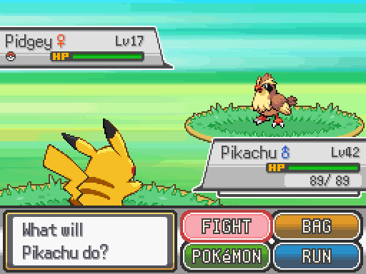
Origin of the Data
The original Pokémon is a role-playing game based around building a small team of monsters to battle other monsters in a quest to become the best.
Pokémon are divided into types, such as water and fire, each with different strengths.
Battles between them can be likened to the simple hand game rock-paper-scissors.

Slide 4
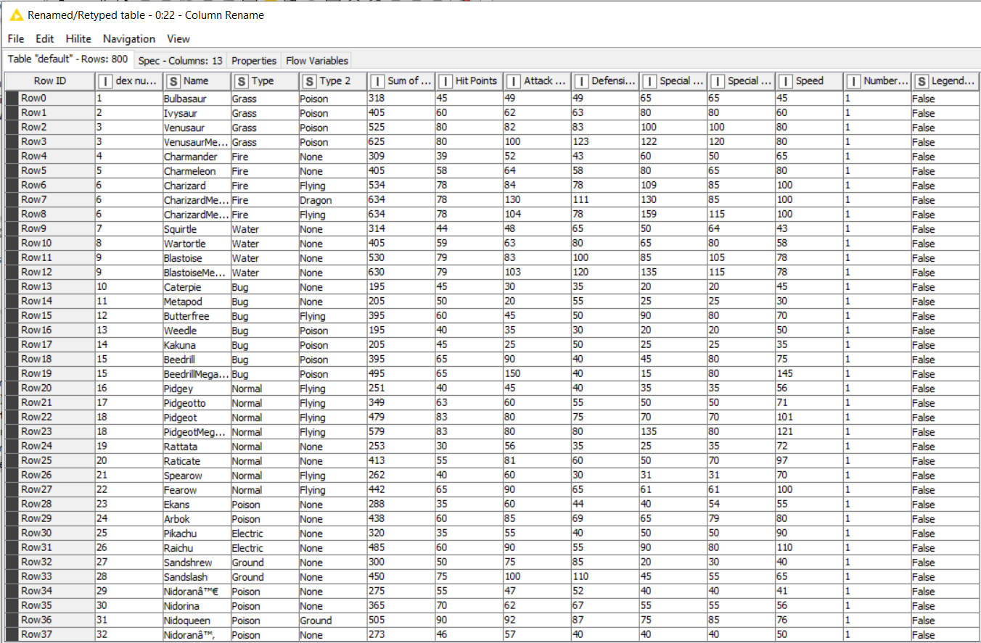
Business Understanding
We have the data of Pokémon; their types and other fight attributes are listed which are unique to each Pokémon.
The goal is to find the optimum number of clusters biased on the overall strength of the Pokémon.
For a fair fight among Pokémon, each trainer needs to pick a single Pokémon from each cluster.
The optimum number of clusters would help us decide what number of Pokémon when fought together result in a fair fight.

Slide 5
Data Understanding
This data set includes 721 Pokémon, including their number, name, first and second type, the stat total and basic stats: HP, Attack, Defense, Special Attack, Special Defense, and Speed, generation, and legendary status.
All columns are numeric except for Name, Types and Legendary.
These are the raw attributes that are used for calculating how much damage an attack will do in the games.
There are some missing values in Type 2 column as some Pokémon only possess a single type

Slide 6
Defining Attributes
Dex Number: The ID for each Pokémon
Name: The name of each Pokémon
Type 1: Each Pokémon has a type, this determines weakness/resistance to attacks
Type 2: Some Pokémon are dual type and have 2
Total: Sum of all stats that come after this, a general guide to how strong a Pokémon is
HP: Hit points, or health, defines how much damage a Pokémon can withstand before fainting
Attack: The base modifier for normal attacks (e.g., Scratch, Punch)
Defense: The base damage resistance against normal attacks
SP Atk: Special attack, the base modifier for special attacks (e.g., fire blast, bubble beam)
SP Def: Special defense, the base damage resistance against special attacks
Speed: Determines which Pokémon attacks first each round
Generation: The generation of games where the Pokémon was first introduced
Legendary: Some Pokémon are much rarer than others, and are dubbed "legendary"

Slide 7
Data Preparation
We make sure no values are missing. Using the missing value node, we replace the empty rows with type 2 with “None”.
We also use column rename to name out columns according to the attributes.
We use column filters, normalizer, denormalizer and other nodes to prepare the most accurate and useful data
We make sure the data is relevant and no unnecessary data is being processed, hence we ill remove Pokémon names and ID columns.

Slide 8
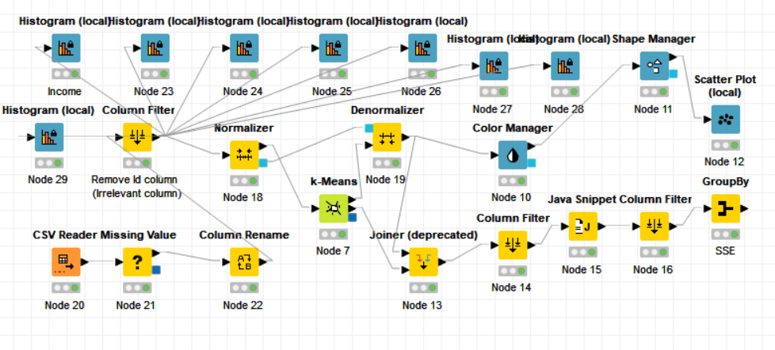
Modeling

Slide 9
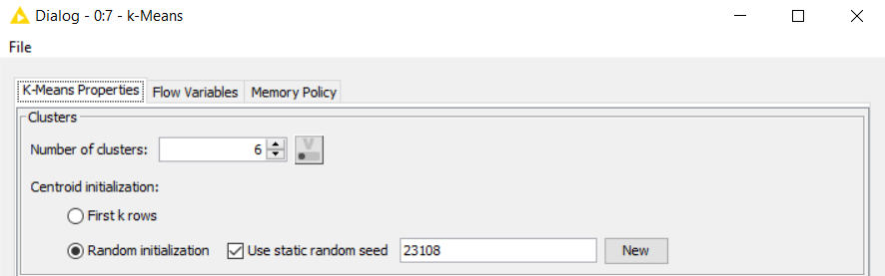
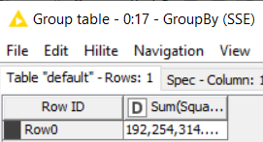
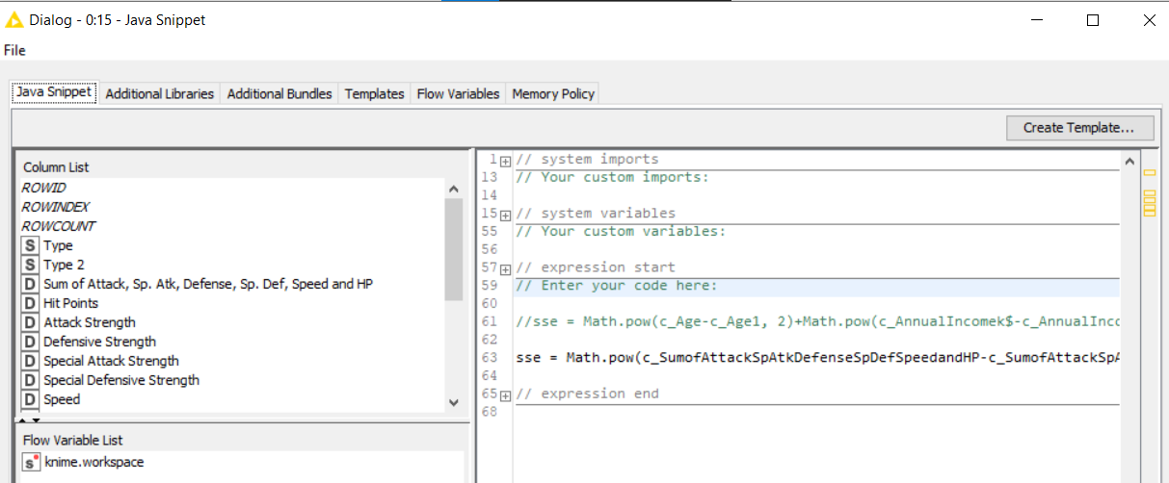
Using ERP in K-means
We start with number of cluster=2
Using Java Snippet, we write the formula
Finally using group by we have our values
We repeat the process with different number of clusters and collect different SSE values to plot an Elbow curve

Slide 10
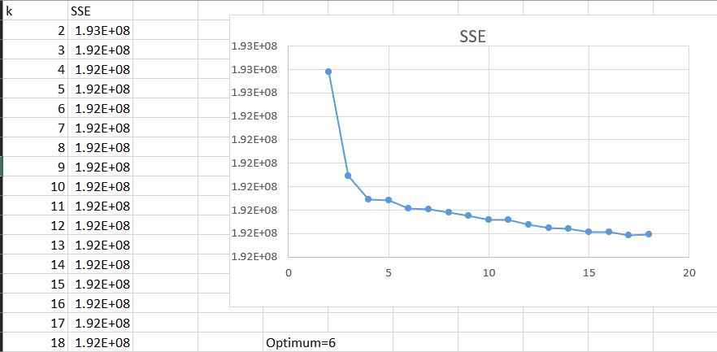
Elbow Curve

Slide 11
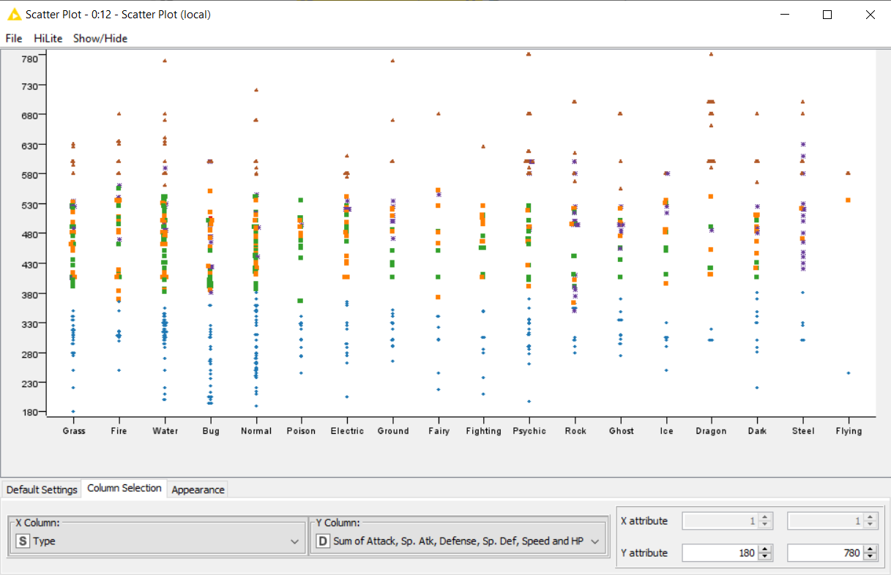
Evaluation
Using the scatter plot we observe that the clusters are prepared according to the attack ability of each Pokémon irrespective of its type
We can see the horizontal blue cluster which consists of Pokémon with low sum of attack etc., while the red triangle cluster contains Pokémon with high sum of attack etc.

Slide 12
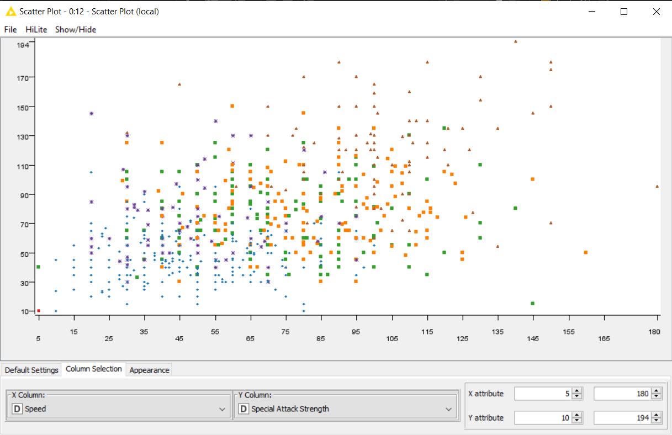
We can also observe relationships between other attributes which make logical sense such as the blue cluster with low speed also has low special attack strength while the red triangle cluster in the top right side of the graph has higher speed as well as high special attack strength

Slide 13
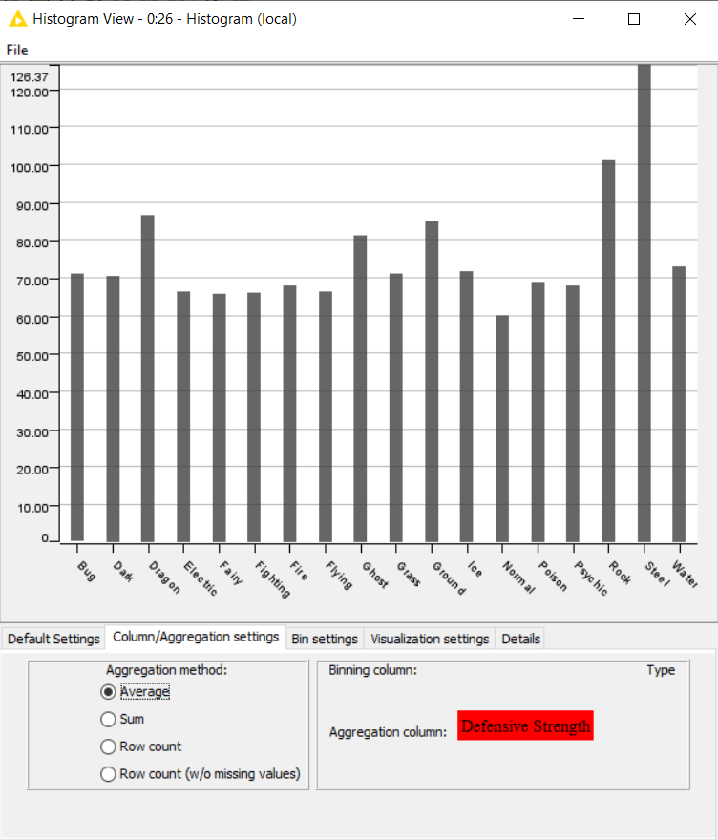
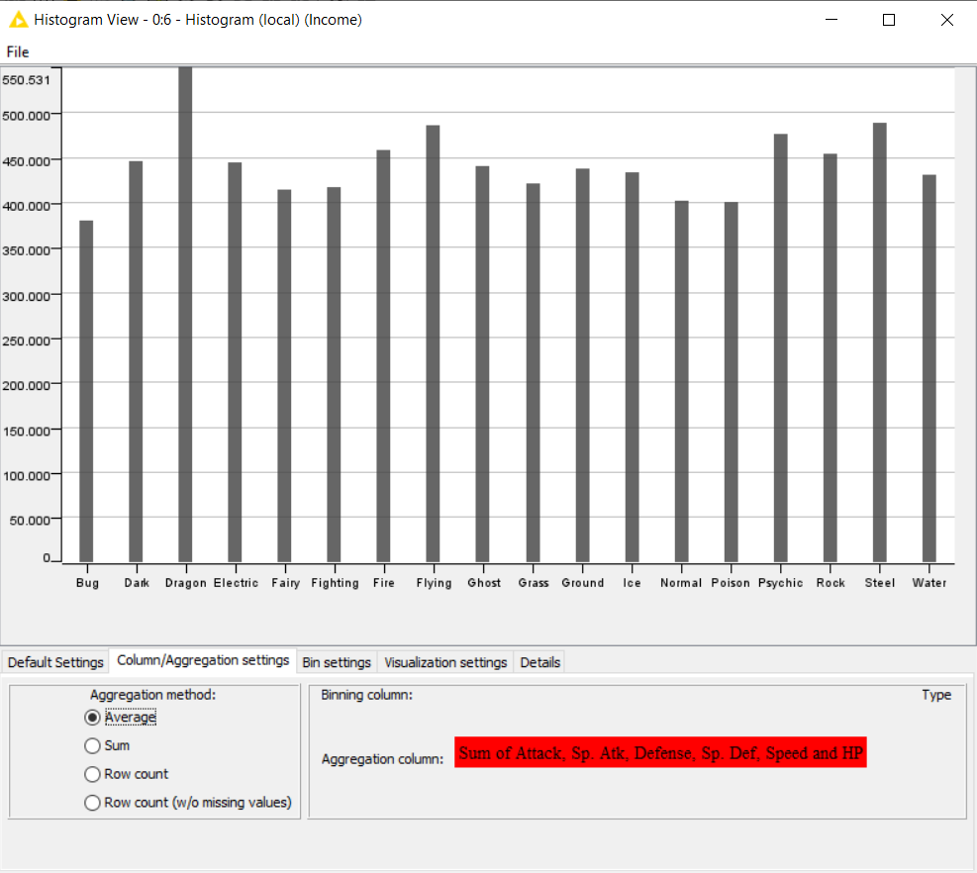
Interesting Relationships
When we draw bar charts of type of Pokémon with respect to their defense strength or other attributes, we learn that each type of Pokémon on average are usually equally powerful, hence this means that any specific type of Pokémon is not superior to another type on average therefore resulting in a fair fight.

Slide 14
Conclusion
We concluded that the optimum number of clusters is 6, therefore for a fair fight among Pokémon, each trainer needs to pick a single Pokémon from each of the six clusters. Hence in total a trainer should battle with six Pokémon to have the highest probability of a fair fight.
We learn that the game developers of the Pokémon games already calculated the number 6 as currently you can carry at max six Pokémon in all the Pokémon role-playing games(RPG). The game has already deployed and is loved by millions.
If all the Pokémon fought in an open field, again the fight would be fair, and there would be a unique winner every time.
Moreover, there are a large number of permutations and combinations of attacks and Pokémon that make the game extremely fair and fun to play.

Slide 15

Thank you!

